Slide 1
E-Commerce Analytics Dashboard
Uncovering insights into sales, delivery, and customer behavior using SQL & Tableau
Name: Chukwuemeka Nnamani — Data Analyst Portfolio Project
Tools: SQL Server • Tableau Public • PowerPoint
Date: November 2025
Hello, my name is Chukwuemeka Nnamani, and this is my E-Commerce Analytics Dashboard — a data-driven project where I analyzed sales, delivery, and customer patterns using SQL and Tableau. My goal was to turn raw data into actionable insights that improve business performance.

Slide 2
Why This Project?
E-commerce companies struggle with understanding what drives sales growth, customer retention, and delivery performance.
This analysis focuses on revealing insights from over 100k orders to help identify growth opportunities and operational inefficiencies.
The goal: help decision-makers make smarter moves using data
The project idea came from a common business challenge — understanding customer and sales dynamics in e-commerce. Using the Olist dataset from Kaggle, I wanted to uncover what drives profitability, how delivery affects retention, and where improvements can be made

Slide 3



Data Sources & Tools
Dataset: Brazilian Olist E-Commerce Dataset
Data Volume: 100k+ orders, 3 years of data (2016–2018)
Tools Used:
SQL Server – data cleaning, queries, calculations
Tableau – visualization & storytelling
Data Preparation: joined multiple tables (orders, customers, sellers, products, reviews)
I began with raw CSV files in SQL Server, cleaned and prepared the data, then extracted key KPIs like revenue, AOV, delivery time, and retention. Tableau was used to visualize insights and create an interactive dashboard.

Slide 4




Key Performance Indicators (KPIs)
Total Revenue
$8.45M
Total Customers
51,607
Average Order Value
$136.8
Average Review Score
4.14
To measure business performance, I focused on core KPIs that reflect profitability, customer behavior, and service quality.
These metrics gave a balanced view of how well the business was performing — not just in terms of sales, but also customer satisfaction.

Slide 5
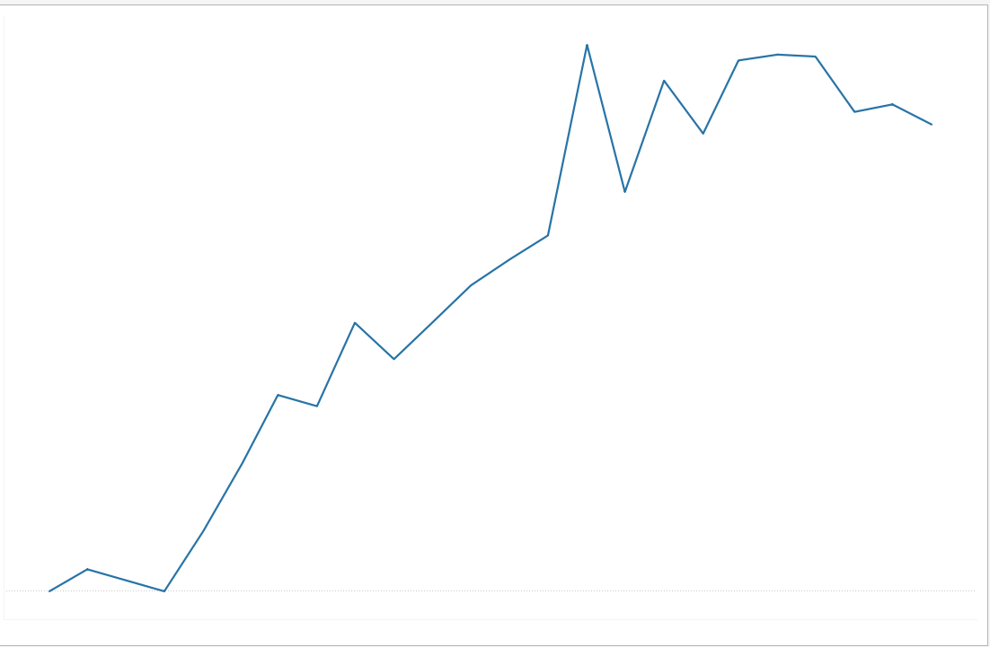
How has revenue changed over time?
Revenue peaked in 2018 with strong monthly growth consistency.
The overall upward trend suggests increasing customer demand and effective sales performance.
2016 was limited, but 2017–2018 show stable scaling.

Slide 6
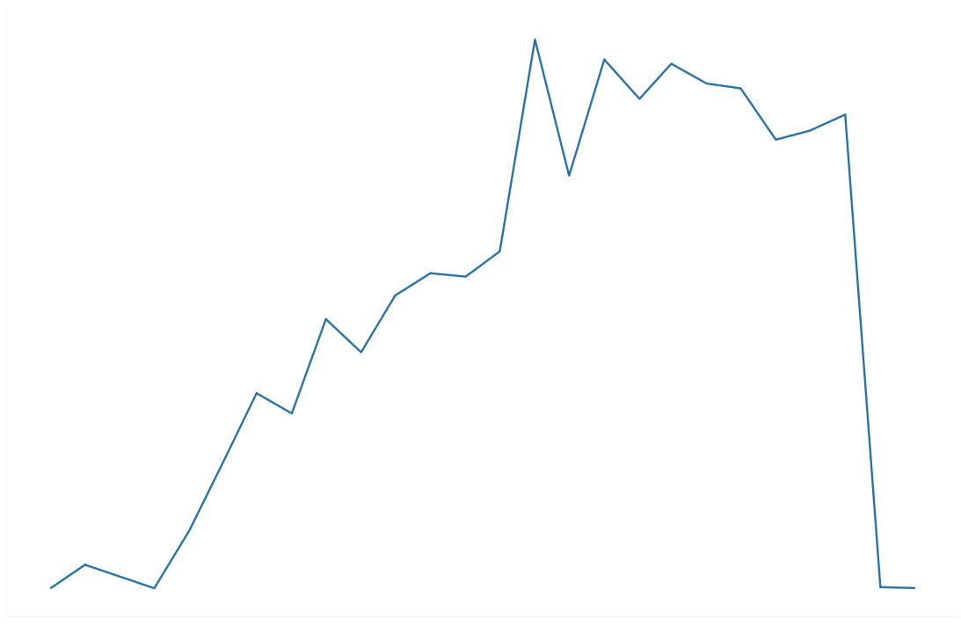
Are we gaining more customers each year?
Unique customers increased significantly between 2016 and 2018.
2017 shows the largest jump (over 15,563.20% increase).
This indicates growing market penetration and brand awareness.

Slide 7
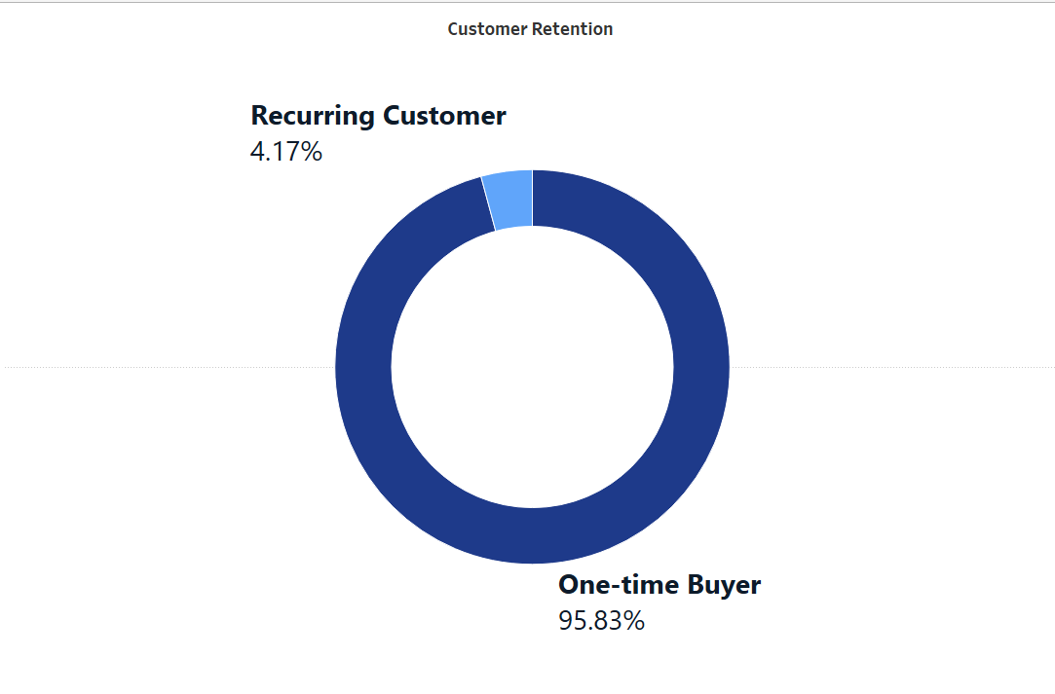
How many customers return vs buy only once?
Majority are one-time buyers (95.83%).
Returning customers are still a small percentage (4.17%).
Opportunity exists to improve retention strategies (discounts, loyalty programs, faster delivery).

Slide 8
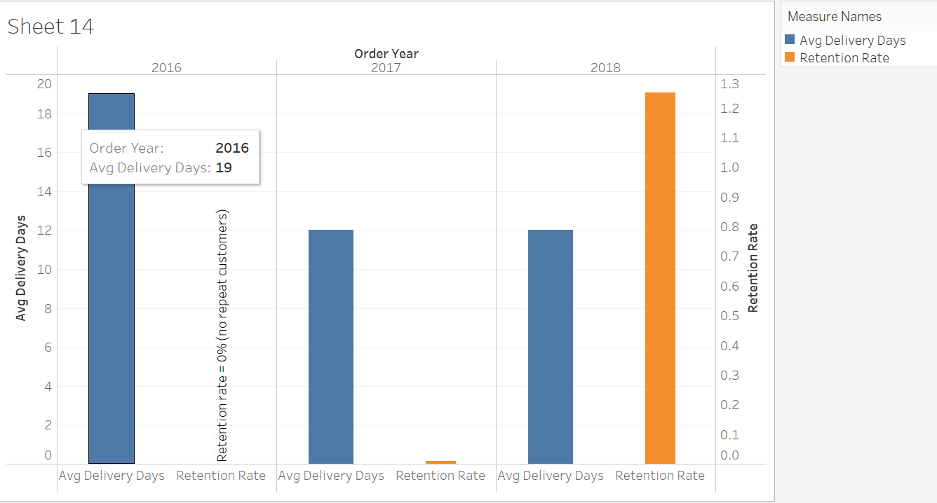
Is delivery speed improving over the years and does it improve retention rate?
Average delivery days reduced from 19 days (2016) to 17 days (2018).
Faster delivery aligns with higher customer retention, the more average delivery days decreased
the more there are returning customers just as 2017 and 2018 shows.

Slide 9
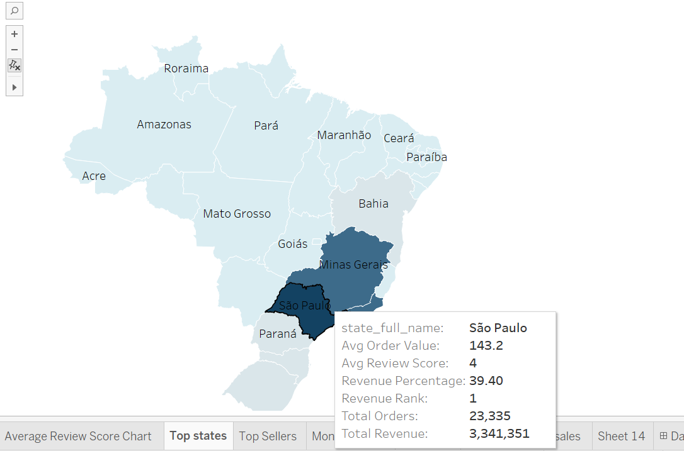
Which states drive the most orders and revenue?
São Paulo dominates by a wide margin (39.5% of total revenue).
Rio de Janeiro and Minas Gerais follow.
These regions should remain focal points for logistics optimization and marketing investments.

Slide 10
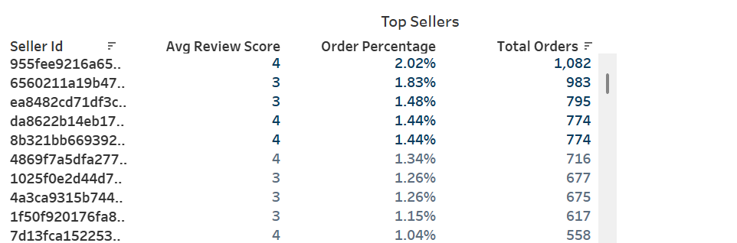
Who are our most valuable sellers?
Top sellers account for a large share of orders.
High review scores correlate with higher order volume.

Slide 11
Executive summary
Business Performance
Revenue and customer volume increased steadily from 2016–2018.
2018 recorded the highest performance across all major KPIs.
Southeast states (São Paulo, Rio, Minas Gerais) dominate revenue contribution
Customer behaviour
Large majority of customers are one-time buyers (~X%).
Returning customers place larger and more frequent orders.
Repeat buyers have higher lifetime value but make up a smaller portion.
Operation and delivery
Delivery speed improved from 19 to 17 days on average.
Top sellers with faster delivery and higher ratings attract more buyers.

Slide 12
FINAL RECOMMENDATIONS
Improve Customer Retention
Introduce loyalty rewards for repeat buyers
Offer targeted discounts for customers inactive for >60 days
Promote bundles to increase order value
Optimize Delivery Speed
Strengthen partnerships with faster delivery carriers
Add regional hubs for Southeast and South regions
Promote bundles to increase order value
Invest in High-Performing Sellers
Highlight top sellers on the homepage
Offer priority visibility to sellers with high ratings
Provide training to low-performing sellers to improve delivery and rating scores
Expand in High-Revenue States
Prioritize marketing in São Paulo, Rio, Minas Gerais
Launch region-specific promotions during peak months
Improve logistics coverage in these states to support higher demand

